Slide 1
Lecture 15
Practice & exploration
Subfunctions: Functions within functions
“Guessing Game”: A hands-on exercise in evolutionary design
© 2010 Daniel Valentine. All rights reserved. Published by Elsevier.

Slide 2
Application of the tools in MATLAB
The programming tools investigated in this course are, of course, intended to be combined in your computer programs to solve your technical computing problems.
When you, as an engineer or scientist, need to write a program in MATLAB to accomplish a technical computing task, the more you learn about MATLAB the better; we have only touched the surface of the capabilities of MATLAB!

Slide 3
Subfunctions
Subfunctions are functions that are used by other functions. They allow you to separate tasks within your programs.
Subfunctions are often used as “utility functions” to perform calculations within a main function.
Another use for subfunctions is printing values to the command window. This is used to separate the mathematical tasks of a function from the print-statement output tasks.

Slide 4

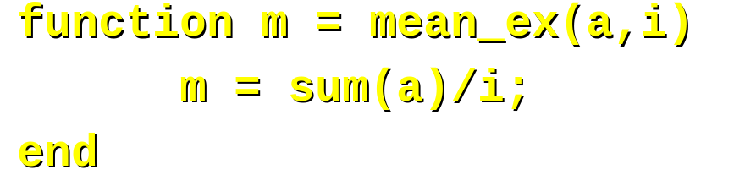






Example of subfunctions
Consider writing a function that calculates the mean
of a set of random numbers. You can write a function to
generate the random numbers and a subfunction to
calculate their mean as follows:
Mean is 0.4531.

Slide 5
Guessing Game Exercise
In this exercise you are going to combine many of the concepts you have learned to build a guessing game function.
The approach taken in this exercise is exploratory. MATLAB is used like a note pad to explore the development of a game.
Initially the game we design will be very simple; the design will evolve by re-building it in attempts to enhance its capabilities.

Slide 6


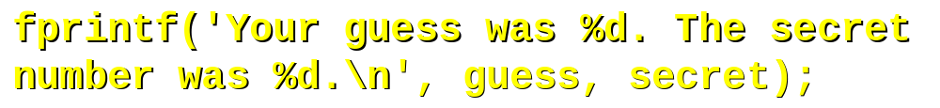
Initial design
The initial game: A “secret number” will be hard-coded into the function. It will prompt the user for a guess and indicate whether it is or is not the secret number.

Slide 7
Sample run
Enter a guess: 3
Your guess was 3. The secret number was 2.
This game is not very interactive (of course); we
only guess once before the game ends. Also,
the game does not check to see if the guess
was too high, too low, or correct. We can
add code to extend the tool to accomplish this.

Slide 8
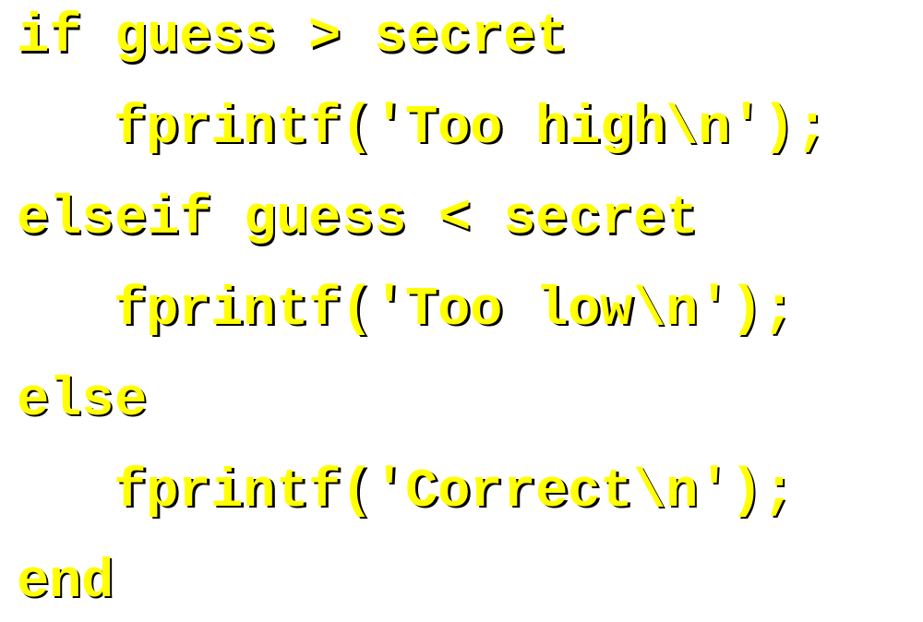
Adding if statements
Add the following set of if statements so that the game tells the user if the guess is too high, too low, or correct.

Slide 9
Sample run
Enter a guess: 4
Too high
Your guess was 4. The secret number was 2.
The guessing game now tells the user if the guess is too high or too low. However, it allows only one guess. Add a while loop to allow for multiple guesses until the guess is correct.

Slide 10
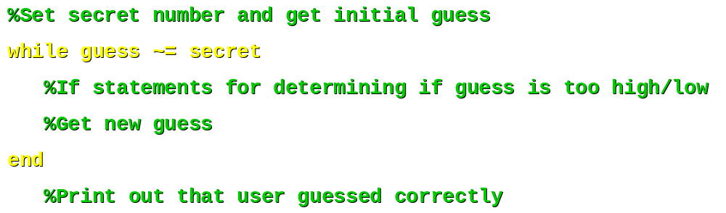
Adding a while loop
The following modification lets the user guess until the secret number is found:

Slide 11
Sample run
Enter a guess: 1
Too low
Enter a guess: 5
Too high
Enter a guess: 4
Too high
Enter a guess: 3
Too high
Enter a guess: 2
Correct!
The game is more interactive now. However, we always know that the right answer is two. Now add a randomly generated number as the secret number.

Slide 12

Adding random numbers
Replace the hard-coded secret number with the following line; this is intended to give a randomly generated secret number:
This will not do the trick for the reasons described next.

Slide 13
Random number generator
The rand() function generates random numbers from 0 to 1. Used appropriately, we can determine random numbers of an size. This is illustrated next.

Slide 14
Adding random integers
The following formula generates random numbers over a range from “low” to “high”:
secret = (high – low)*rand() + low
Then we need to round the random number for the game, so that we have an integer instead of a decimal number:
secret = round((high – low)*rand() + low)
Let us set the limits of the game to a guess of an integer from 1 to 100.

Slide 15
Sample run
Enter a guess: 50
Too high
Enter a guess: 25
Too low
Enter a guess: 37
Too low
Enter a guess: 45
Too low
Enter a guess: 49
Too high
Enter a guess: 48
Too high
Enter a guess: 47
Correct!

Slide 16
Exercises
Add lines to your guessing game to keep track of the number of guesses it took to get the right answer. Also, add a subfunction with input parameters to allow the user to pick a new range of integers from which to guess.

Slide 17
Summary
In this lecture we learned how to use subfunctions within functions.
In this lecture we learned to use MATLAB as a notepad to develop ideas and code that uses the random number capability of MATLAB.
Remark: This exploratory work ould play important roles in the step of the program design procedure via the Structure Plan

